Slide 1

Phylogenetic analysis
Dikeledi Kekana
Centre for Respiratory Diseases and Meningitis,
National Institute for Communicable Diseases,
A division of the National Health Laboratory Service

Slide 2
What is phylogenetic analysis and why should we perform it?
Phylogenetic tree: A diagram that depicts the lines of evolutionary descent of different species, organisms, or genes from a common ancestor
Phylogenetic analysis has two major components:
1. Phylogeny inference or “tree building” —
the inference of the branching orders, and ultimately the evolutionary relationships, between “taxa” (entities such as genes, populations, species, etc.)
2. Character and rate analysis —
using phylogenies as analytical frameworks for rigorous understanding of the evolution of various traits or conditions of interest

Slide 3
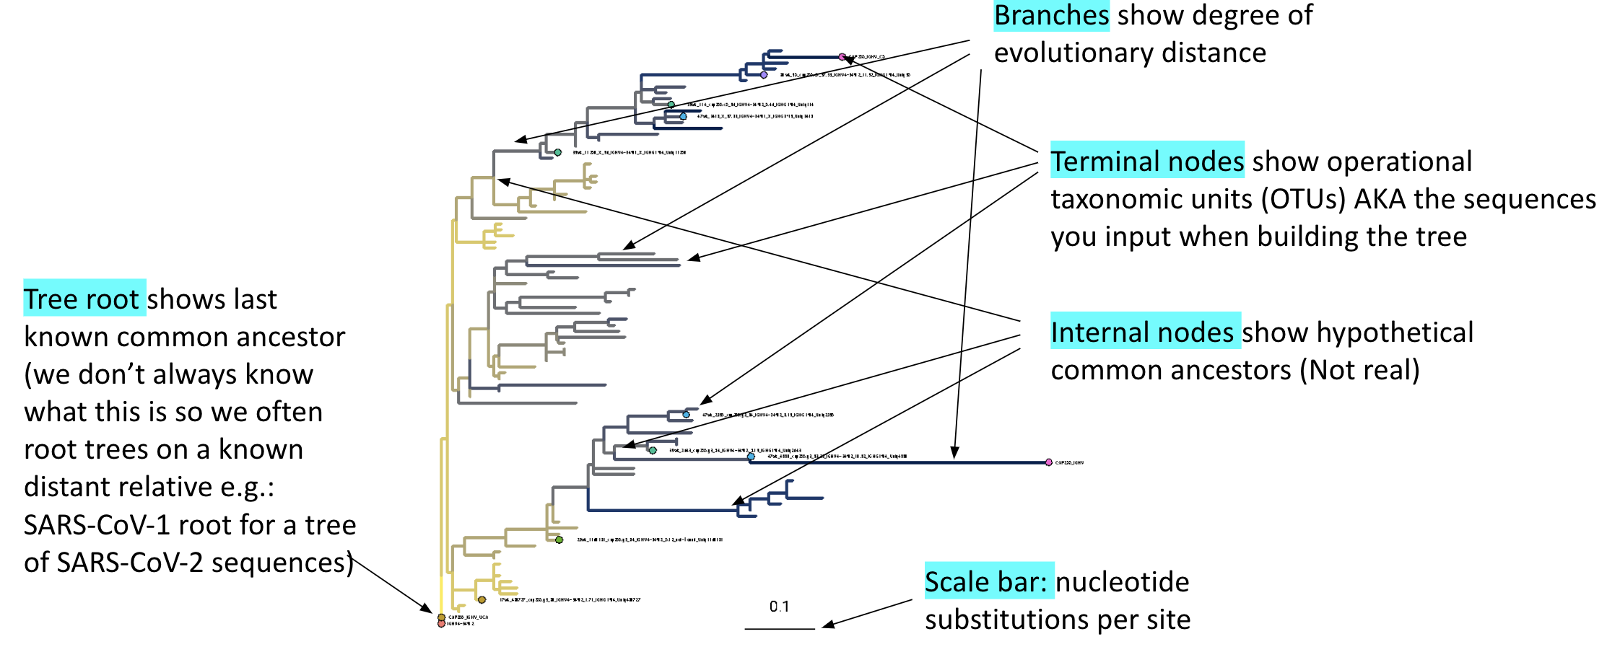
Common Phylogenetic Tree Terminology

Slide 4
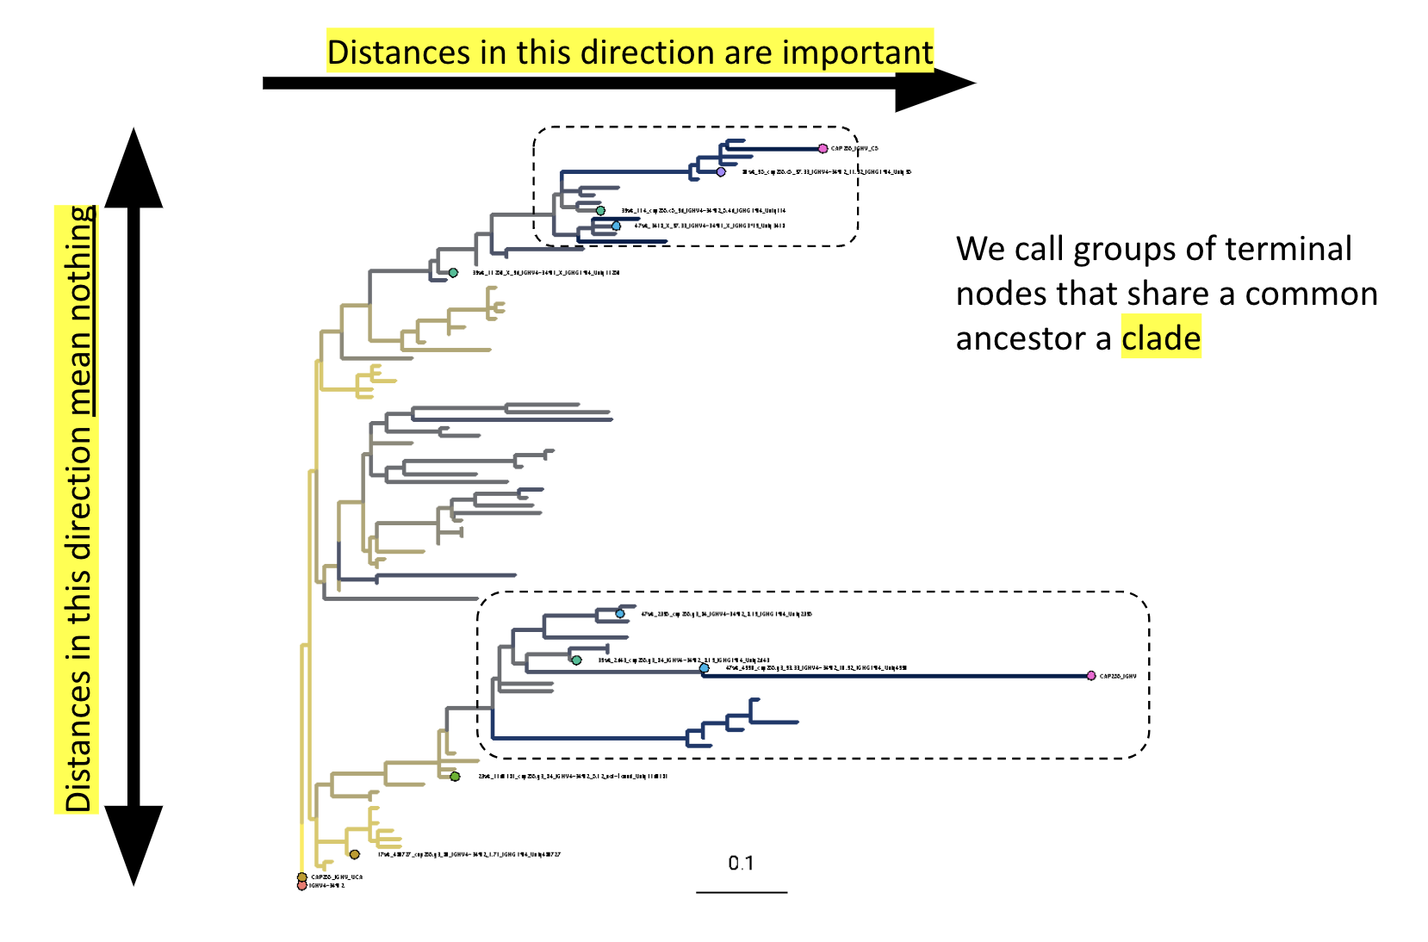
Common Phylogenetic Tree Terminology

Slide 5
A few examples of what can be inferred from phylogenetic trees built from sequence data
Which species are the closest living relatives of modern humans?
Did the infamous Florida Dentist infect his patients with HIV?
What were the origins of specific transposable elements?
Which genetic changes are unique to a specific lineage?
What was the most likely geographical location of the common ancestor of a specific location?
When did specific trait in a lineage arise during evolutionary history?
Plus countless others…..

Slide 6
Which species are the closest living relatives of modern humans?
Humans
Chimpanzees
Bonobos
Gorillas
Orangutans
14
0
MYA
Mitochondrial DNA, most nuclear DNA-encoded genes, and DNA/DNA hybridization all show that bonobos and chimpanzees are related more closely to humans than either are to gorillas.

Slide 7
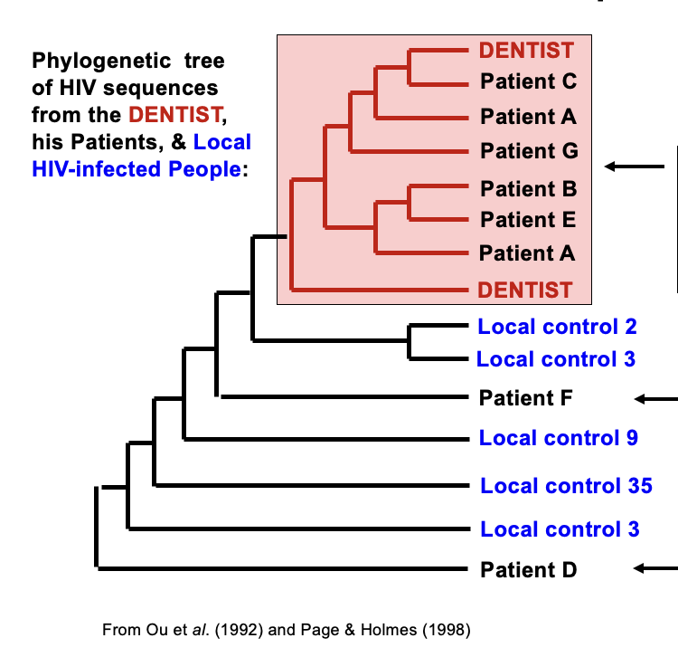
Did the Florida Dentist infect his patients with HIV?

Slide 8
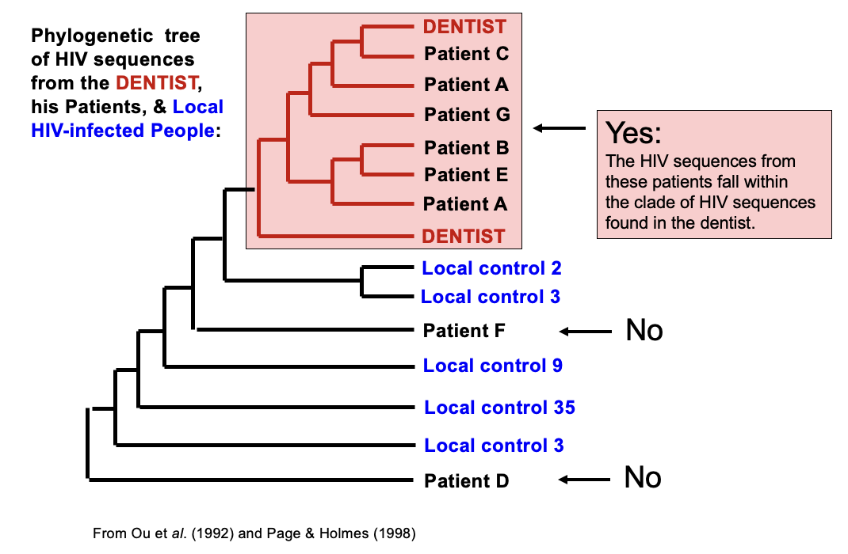
Did the Florida Dentist infect his patients with HIV?

Slide 9
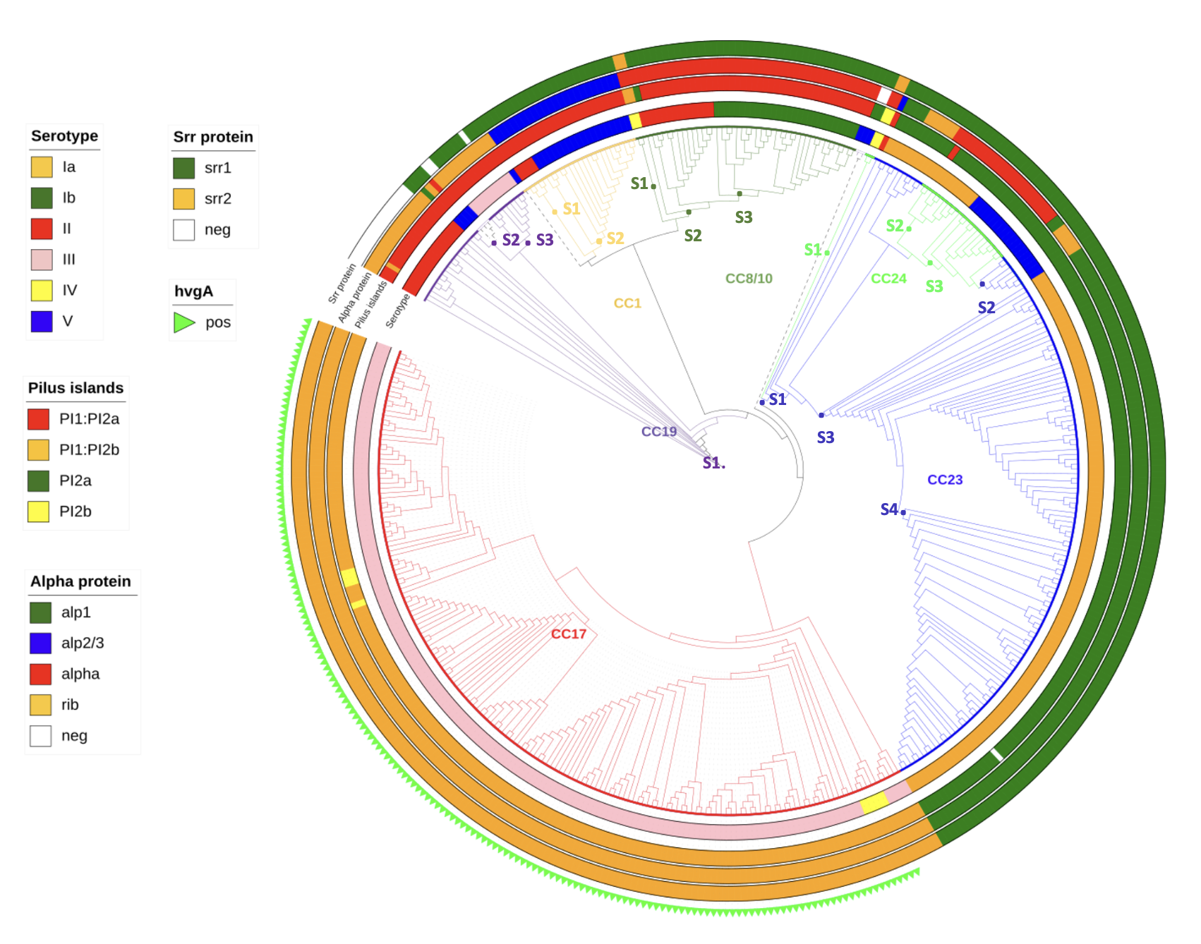
Which genetic traits or changes are unique to a specific lineage?

Slide 10
Interpreting phylogenetic trees
Do these three trees show the same thing? Or are they fundamentally different?

Slide 11
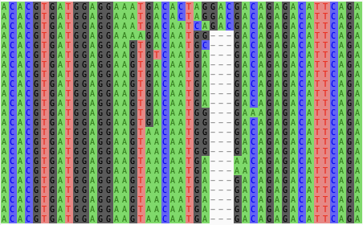
Constructing a phylogenetic tree
Different phylogenetic methods:
Distance Methods
Maximum Parsimony
Maximum Likelihood
Bayesian Methods
Older methods, less computationally intensive
Newer methods, more computationally intensive but more accurate
For most applications Maximum Likelihood will be best

Slide 12
How to construct a phylogenetic tree
Nextclade
MAFFT MUSCLE
…and more
1. Sequence alignment
2. Tree construction
IQtree
RaxML
…and many more
3. Visualize and annotate tree
Figtree: http://tree.bio.ed.ac.uk/software/figtree/
Microreact: https://microreact.org/
ITOL: https://itol.embl.de/
ggtree: R package

Slide 13
1. Sequence alignment
A sequence alignment is a way of arranging the sequences of DNA, RNA, or protein to identify regions of similarity that may be a consequence of functional, structural, or evolutionary relationships between the sequences
Needed for creating phylogenetic trees, quality control
Example tools for doing alignments
NEXCLADE (references available for SARS, Influenza, and more)
MUSCLE
MAFFT

Slide 14


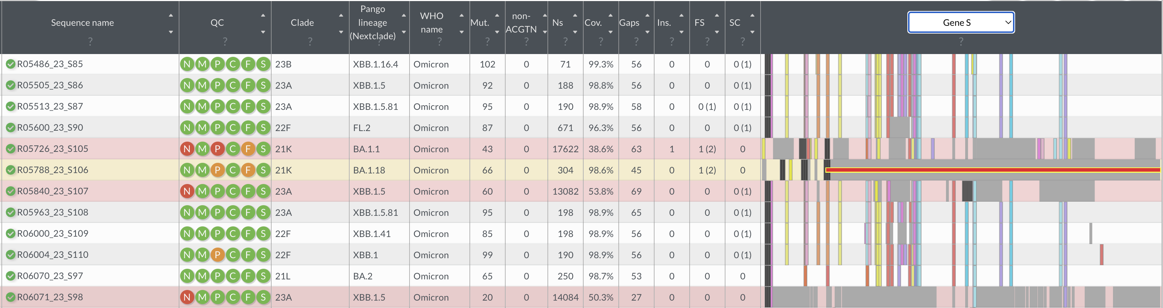
Online program which performs alignment to the reference, clade assignment, reports mutation, and performs sequence quality checks
Total number of mutations
Colours each row by quality.
Grey/white = good
Yellow = mediocre
Red = bad
Lineage assignment
Clade assignment
QC overview
Green = good
Orange = mediocre
Red = bad
Genome/protein visualisation
Hover on mutation for more info
Sequence ID
More details on QC

Slide 15
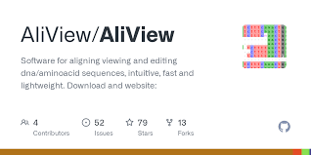
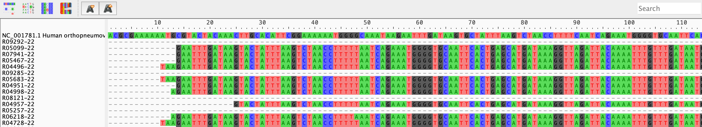
Alignment viewer which allows you to visualize your sequences against one another

Slide 16
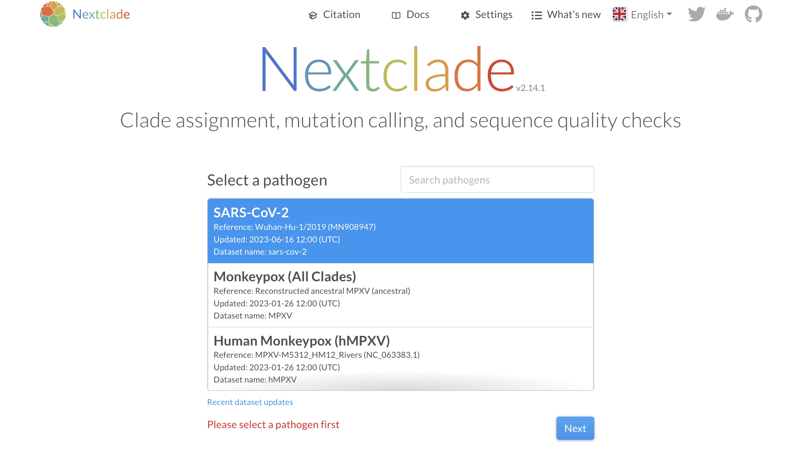
Select reference to align to then click next

Slide 17
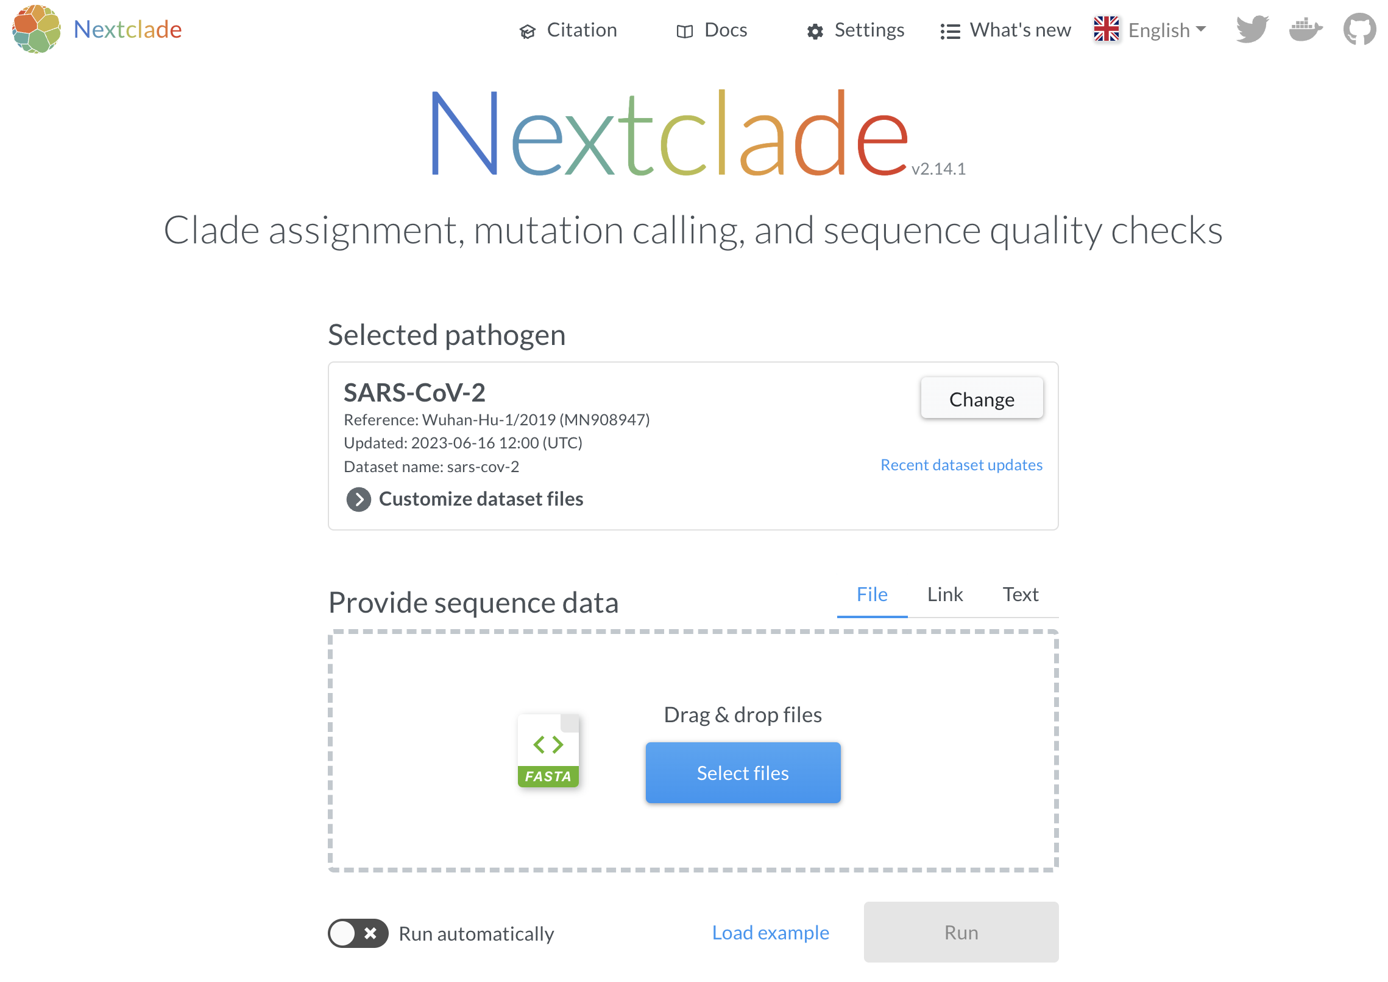
Click to select your fasta or drag and drop
Can also paste fasta as text

Slide 18
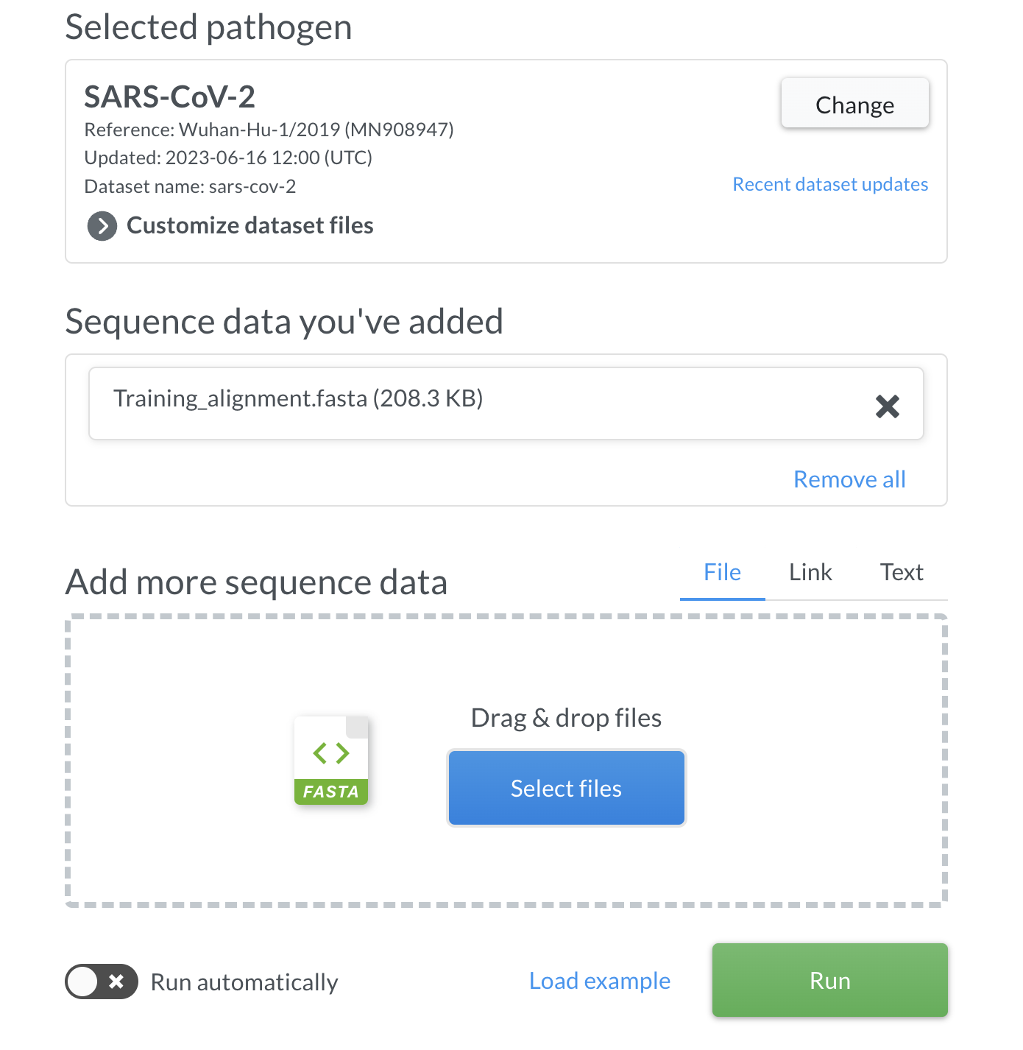
Uploaded file appears here
Then click run to start

Slide 19
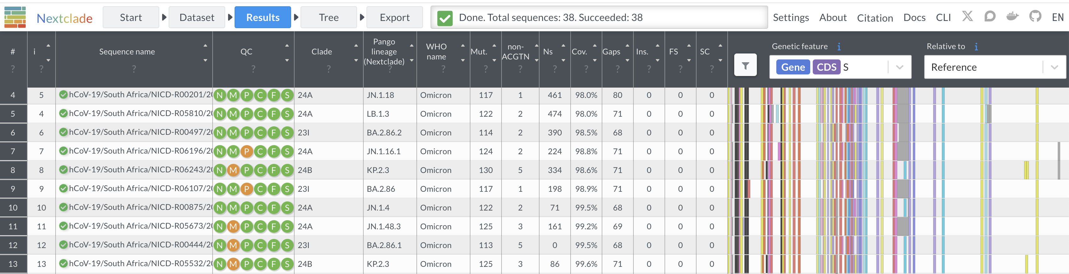
Click to download results

Slide 20
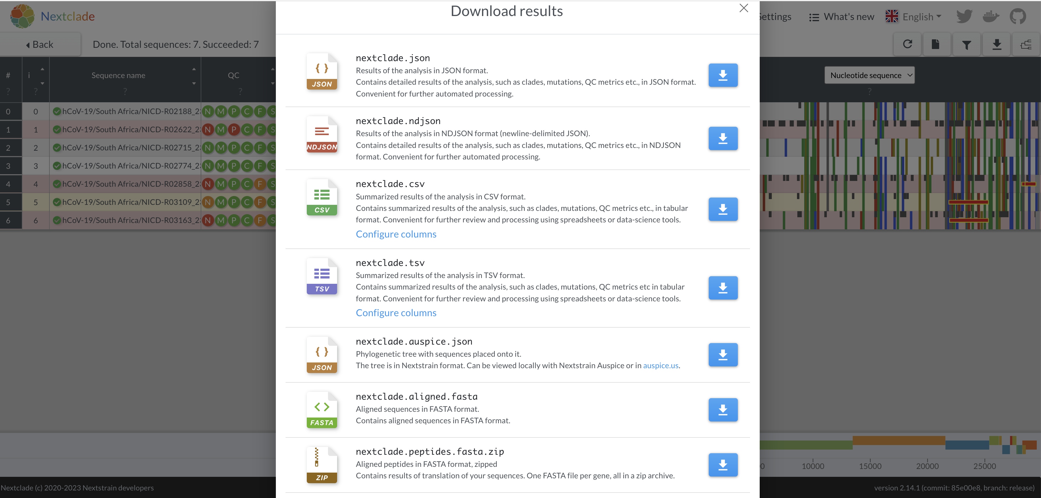
Results can be downloaded in different in different formats
This is the alignment

Slide 21
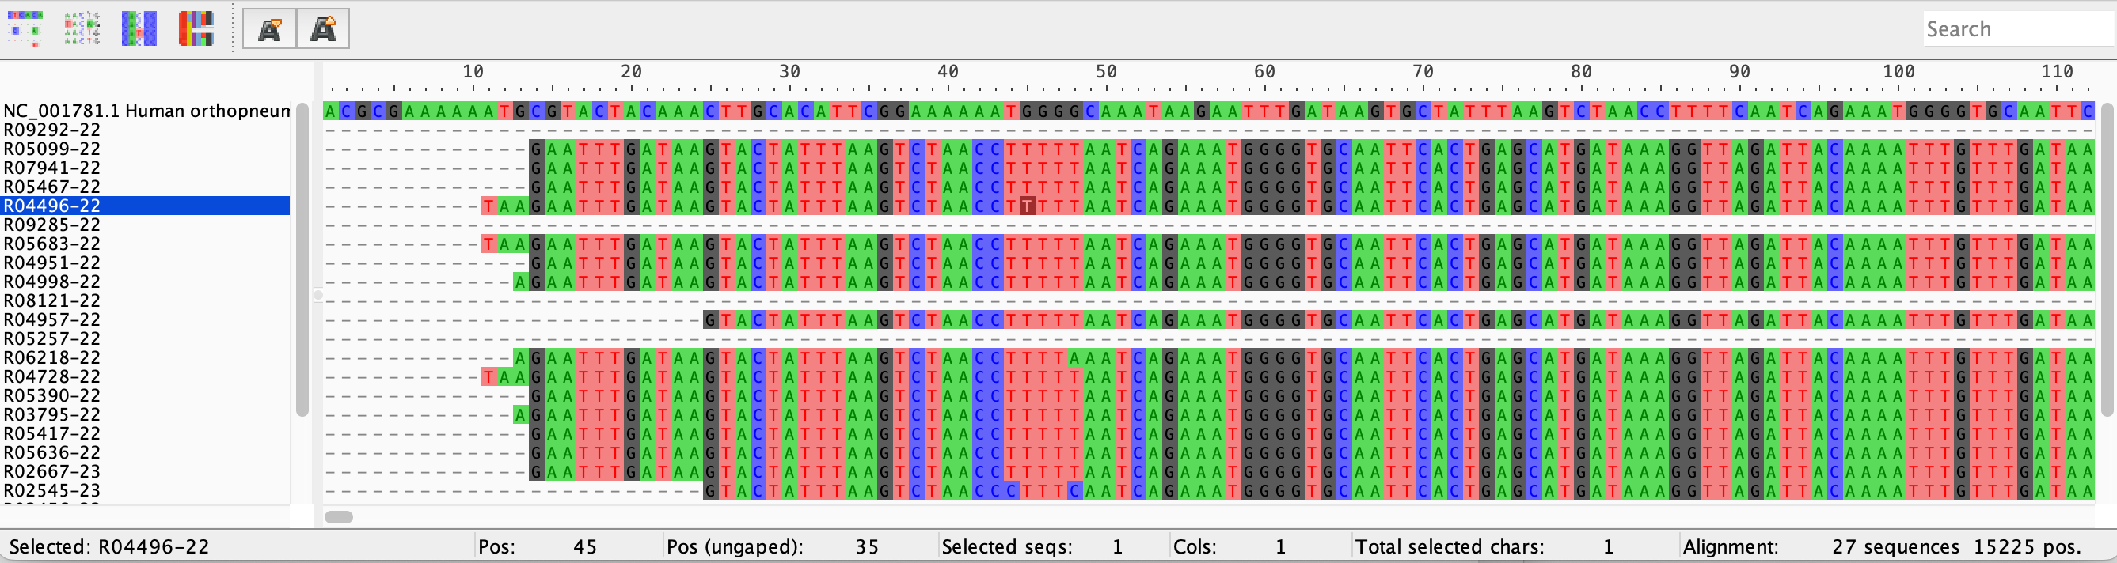
Best to view aligned sequences
Your sequences can be easily aligned and downloaded with nextclade (nextclade.aligned.fasta)
The sequences that you visualize on AliView can be manually editted with the keyboard
Nucleotide position on genome
Selected sequence name
Number of sequences in fasta file/alignment
Position of selected nt
Selected nt base
Mutations
Length of alignment

Slide 22
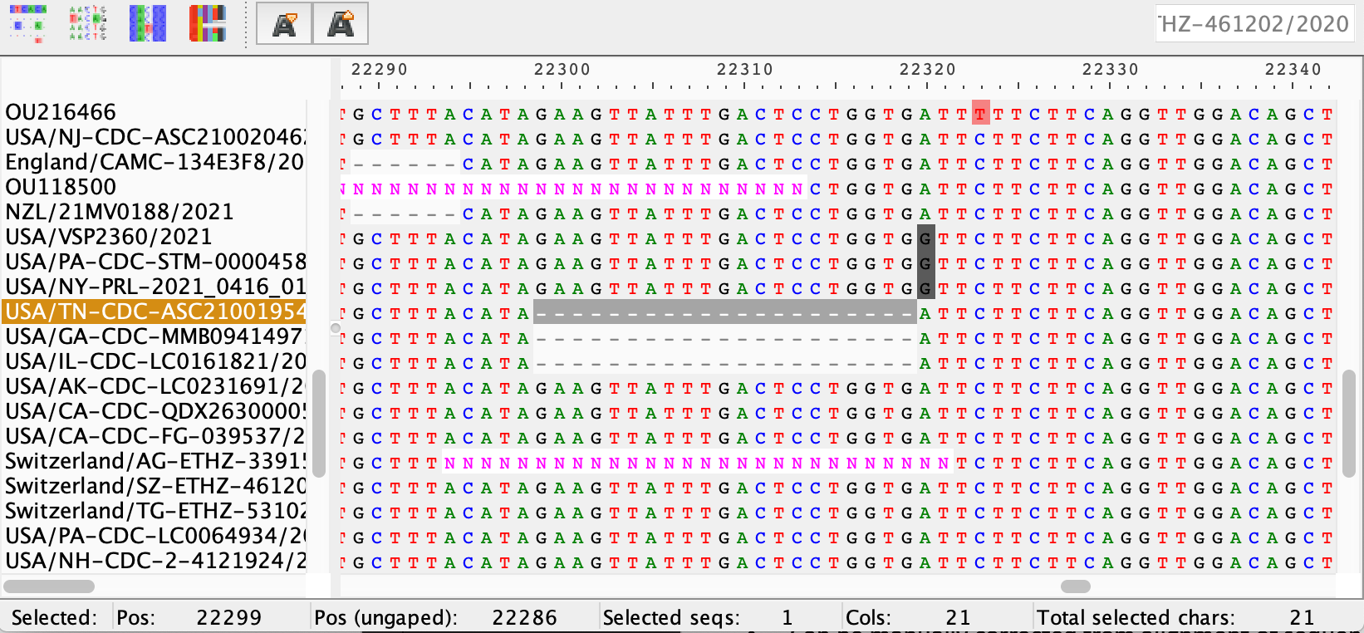
Editing sequences
- Insertion–deletion mutations (indels) refer to insertion and/or deletion of nucleotides into genomic DNA.
- Indels of length not a multiple of 3 must be checked and most probably corrected in the sequence (Frameshifts, i.e. potentially sequencing errors)
- Very large indels are also potentially sequencing errors and must be corrected
- Can be manually corrected from alignment of sequences with AliView by deleting an insertion or replacing a wrong deletion by a series of Ns
- Deletions of length a multiple of three can be kept

Slide 23
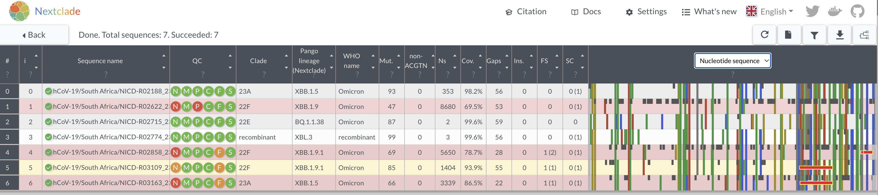
Editing sequences
What a frameshift looks like in Nexclade

Slide 24
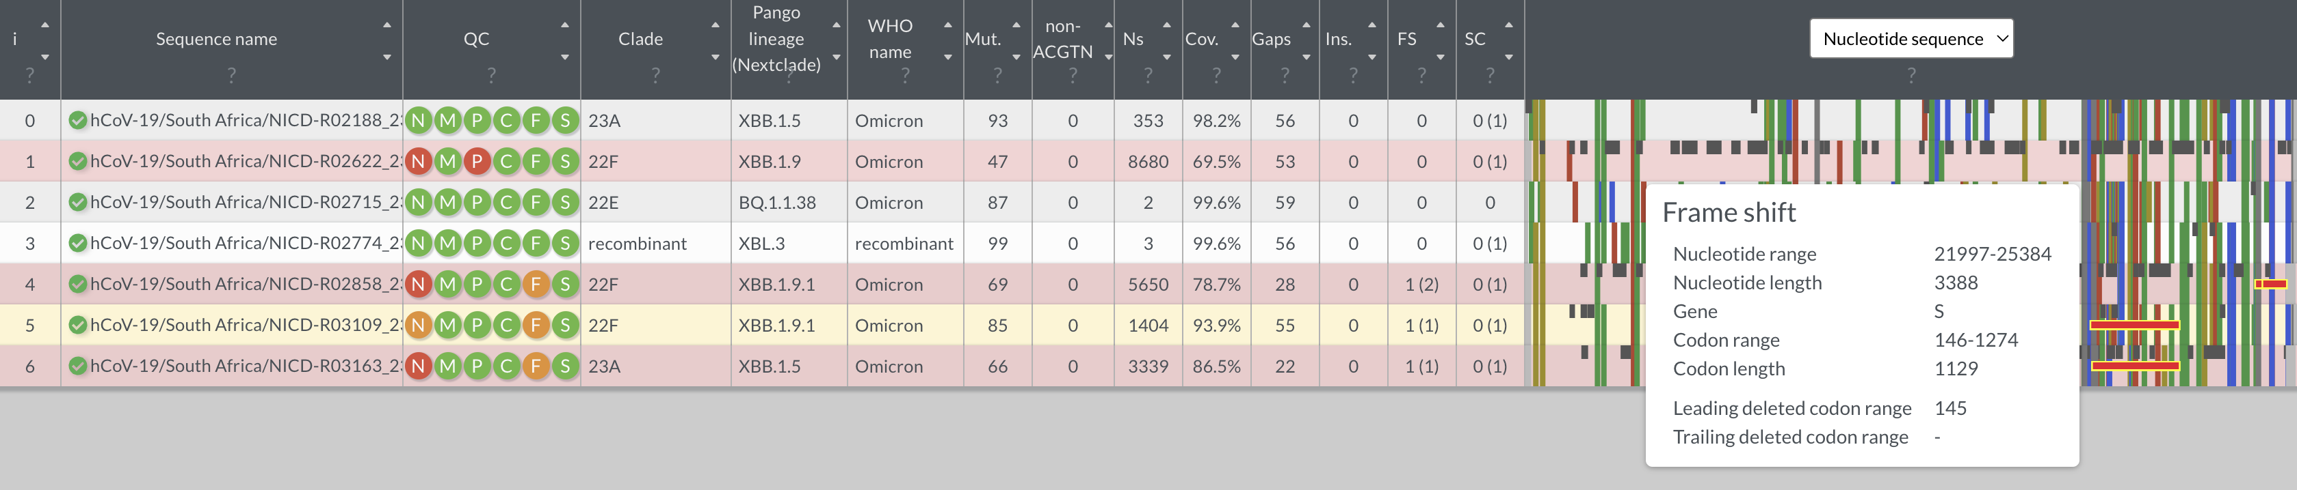
Editing sequences
Hovering over it gives you the position (start to end of frame shifts)
Go to AliView and look for this position to edit

Slide 26
2. Tree construction
The actual construction of the phylogenetic tree
Includes model selection: tools allow model testing step where the program determines the best fit model based on your data
Tools include
IQtree
RaxML
…and many more

Slide 27
2. IQ-TREE
A quick and easy tool for construction of phylogenetic trees
Available as:
Web based version: http://iqtree.cibiv.univie.ac.at/
Command line (https://iqtree.github.io/doc/Quickstart#installation)
Can use any depending on level of expertise.
Will be using the we based version in our practical

Slide 28
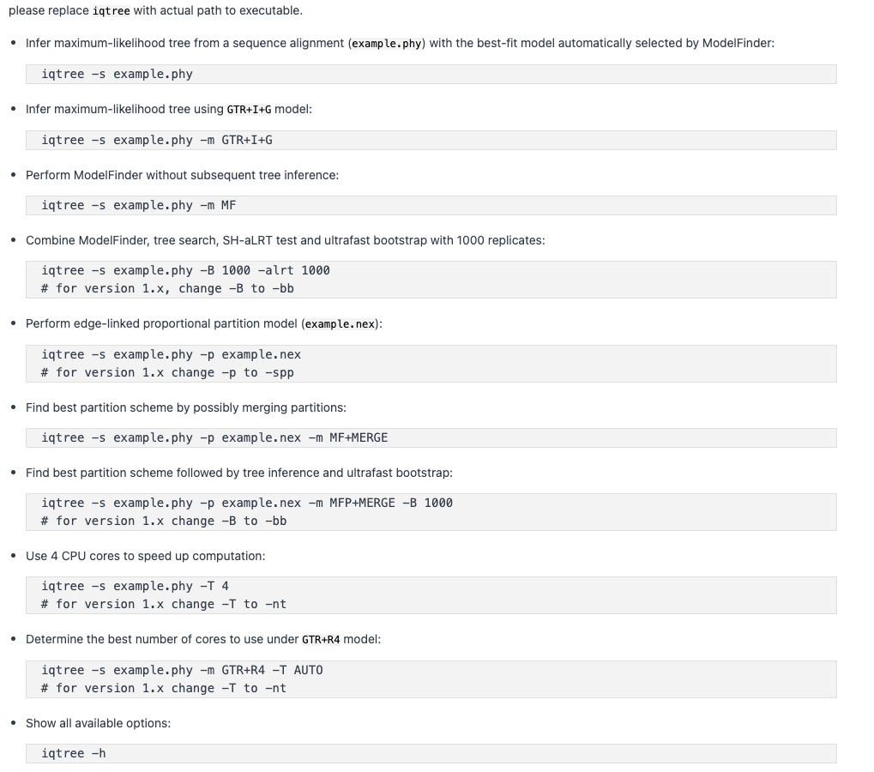
Command line version

Slide 29
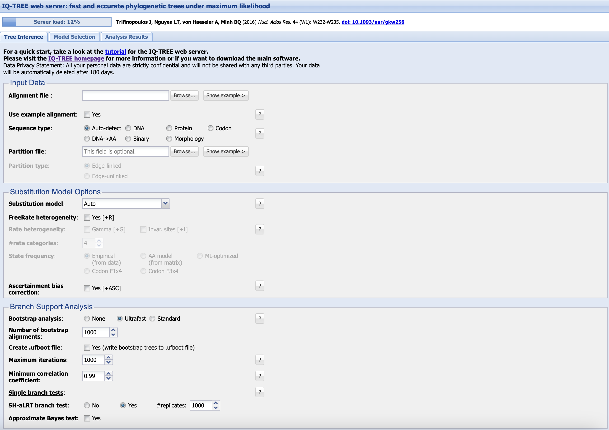

Output files will be in this tab
This is not necessary unless you know that different parts of your sequence are evolving independently
Use when you want to do model test without running the tree
Choosing input file (alignment)
Select sequence type
The choice of substitution model is NB and will affect the accuracy of the final tree. We advise using the built in ModelFinder tool provided by IQ-TREE to choose the best fit model for your data
These parameters help one assess the statistical support for your tree i.e.: how much can you trust your tree to be a good model of the evolutionary relationships between your sequences
Choosing bootstrap replications
Can add email to be notified when analysis is done
Start tree construction

Slide 30
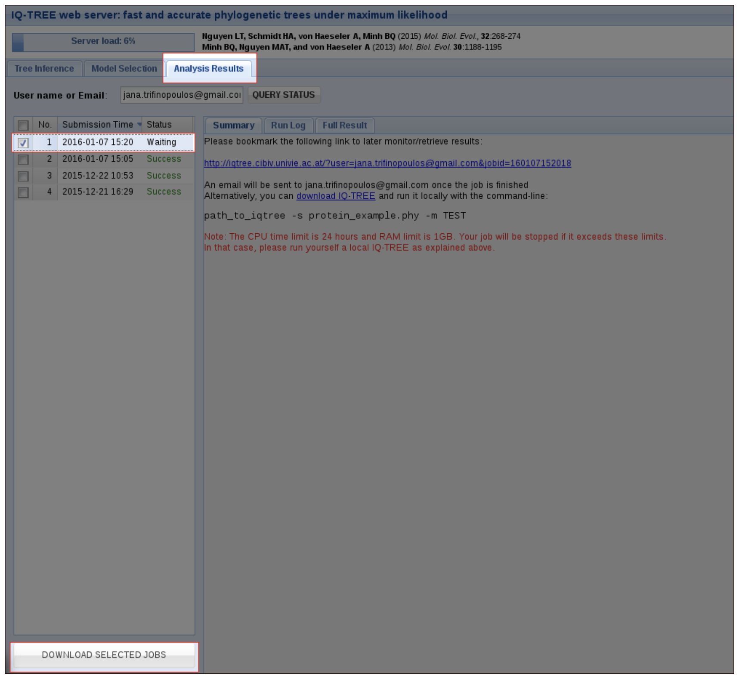
Output files will be in this tab
The output will a tree file which is a text file. Most commonly in the Newick format
Progress of analysis
Select job and click download to save the output files - …is the file of interest (i.e. the tree)

Slide 31
Visualizing and annotating a tree
Plotting and annotating your tree is done using a separate tool to the one you used to construct the tree (convert the text file into a pretty picture)
You should always annotate your tree to more clearly show the relationships you want to highlight:
Colour branches according to time of sequence isolation (if you have longitudinal data).
Label Important terminal nodes
Highlight biologically important clades
The best tool to use is the ggtree R package (https://github.com/YuLab-SMU/ggtree). However this requires you to be proficient in coding in R.
The best ”point and click” tool is ITOL (https://itol.embl.de/)

Slide 32
3. Tree visualization and annotation
Format of a tree is not readable – need a visualization software
Available tools include:
Figtree: http://tree.bio.ed.ac.uk/software/figtree/
Microreact: https://microreact.org/
ITOL: https://itol.embl.de/
ggtree: R package
Tools are also used to annotate the tree (e.g. with metadata)

Slide 33
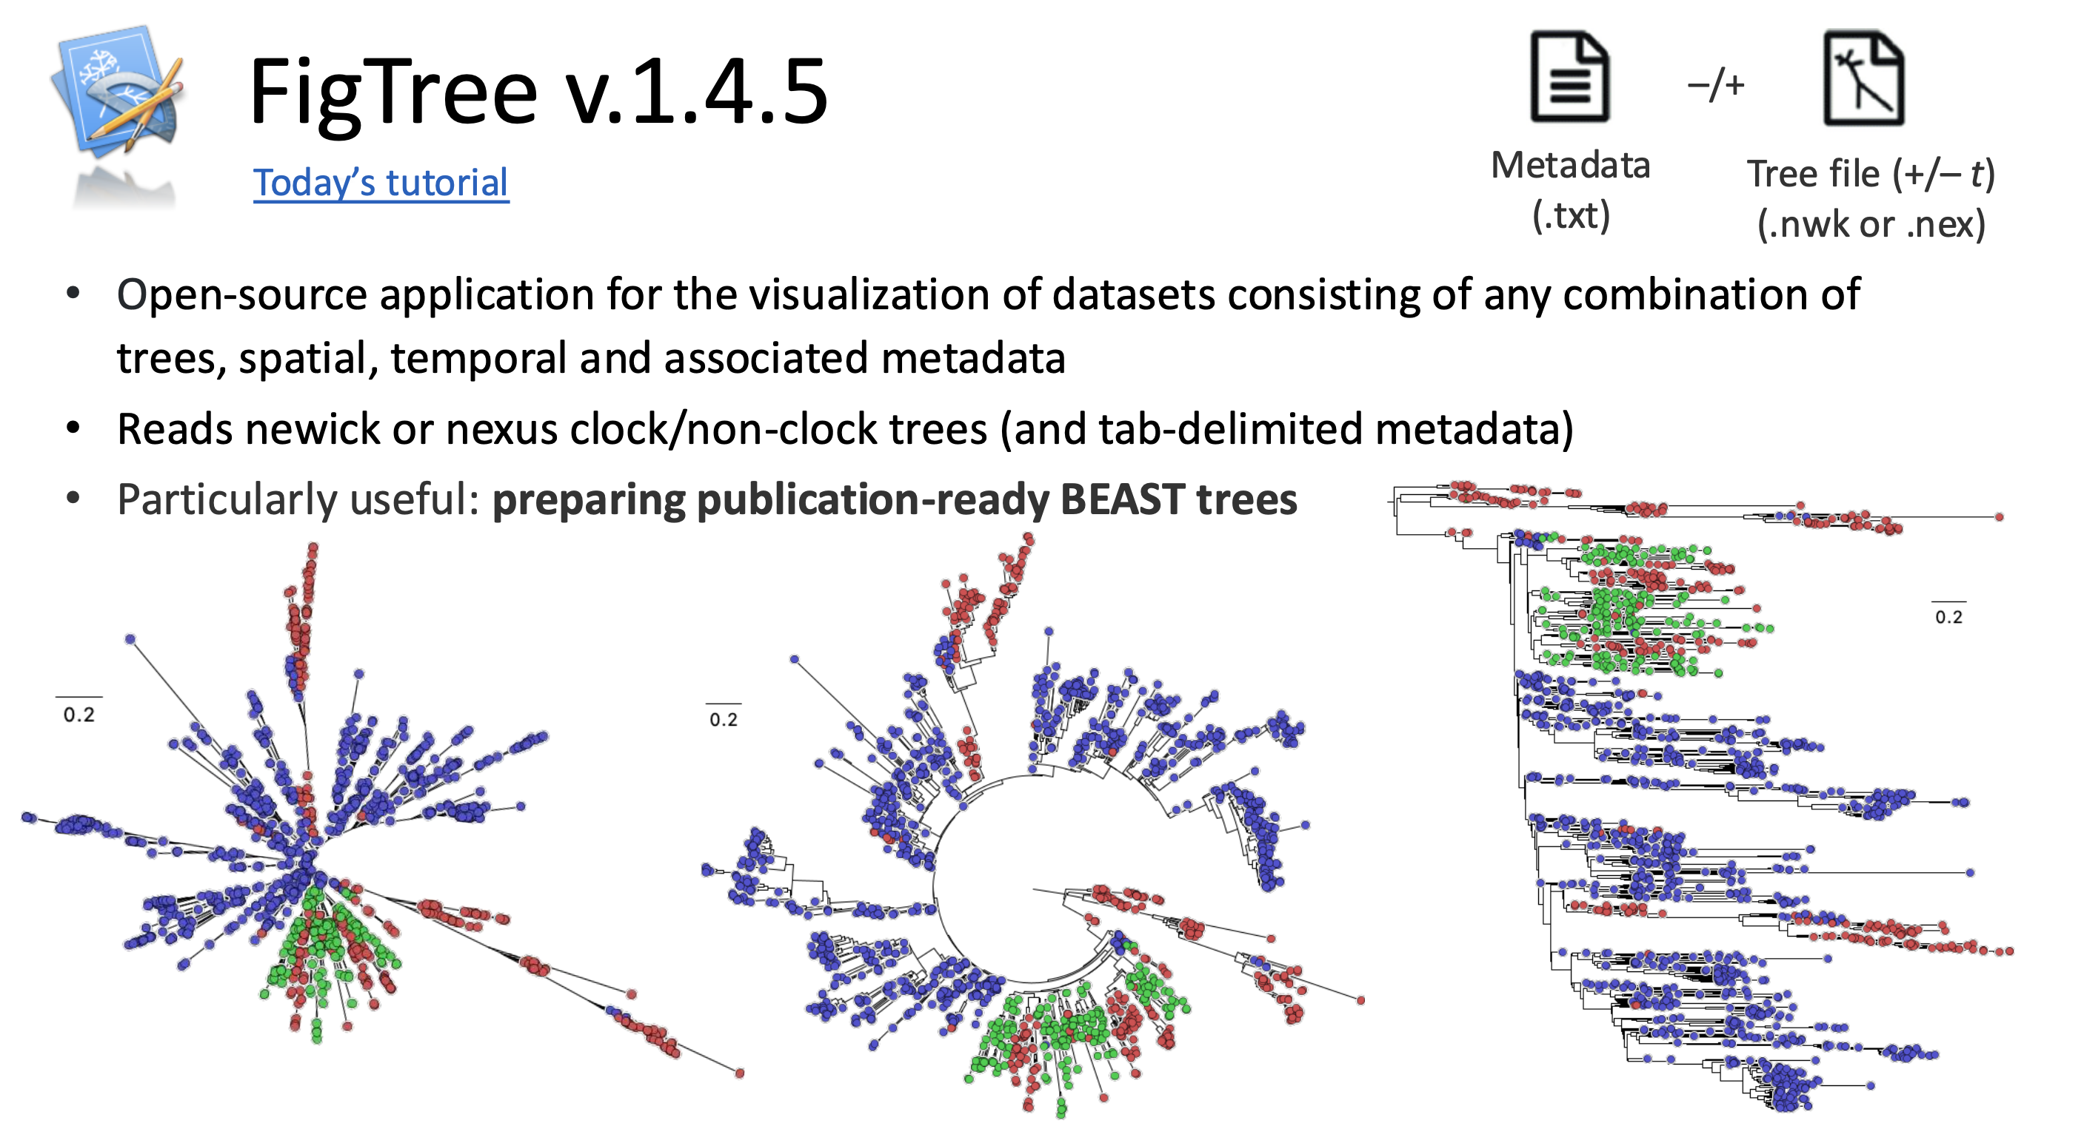

Slide 34
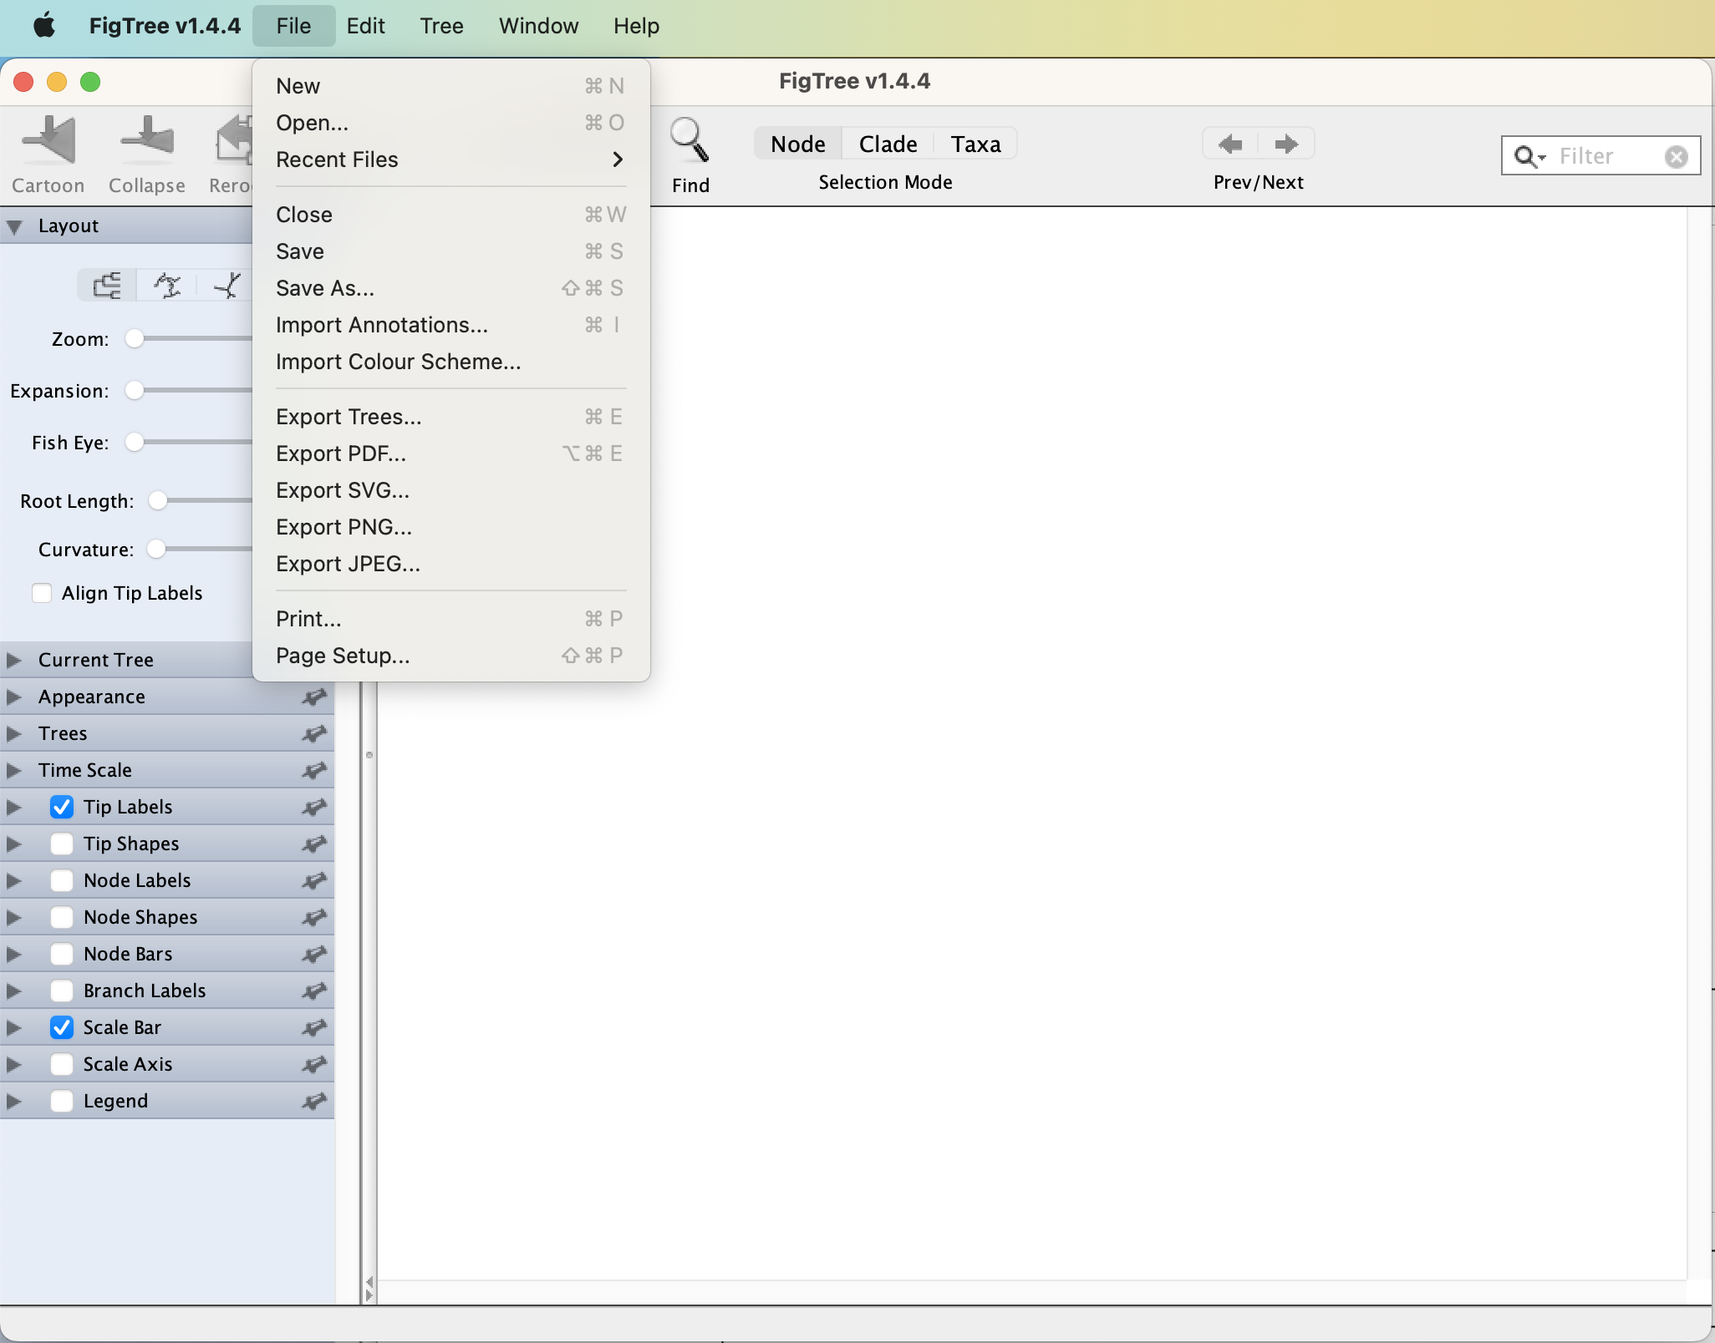
Upload tree
Import annotation file

Slide 35
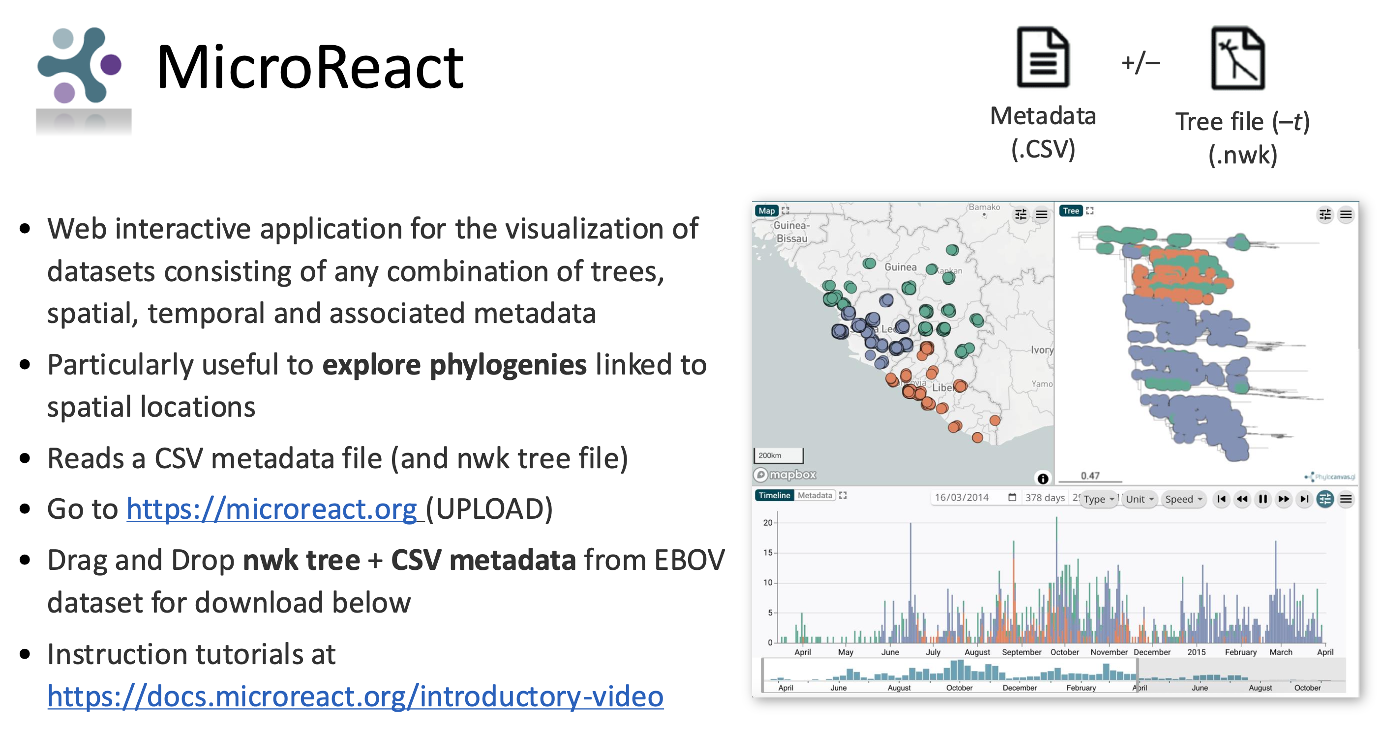

Slide 36
Tree creation demonstration
IQTREE
Nextstrain
1. Sequence alignment
1. Sequence alignment
Nextclade (remember to include a root/reference)
Trim and prune your alignment
Nextclade
2. Tree construction
2. Tree construction
IQTREE
3. Visualize and annotate tree
3. Visualize and annotate tree
FigTree, create annotation file
Microreact, create metadata file

Slide 37


